Slide 1


Microsoft X
Activision Blizzard
Project Report
CKRW Consulting
Christiana Wang, Kathy(Ruoxi) Zhang, Raj Katru, Wilson Weng

Slide 2
Agenda
Problem Statement
Our Approaches
Activision Blizzard Revenue Analysis*
Old Games Analysis*
Metaverse Analysis
Twitch Streaming Data Analysis, 2016-2021*
Metaverse Activities*
Ad Revenue (Social Media X Gender)*
Metaverse Segmentation: Gamer Personas*
*Can be viewed in Tableau

Slide 3
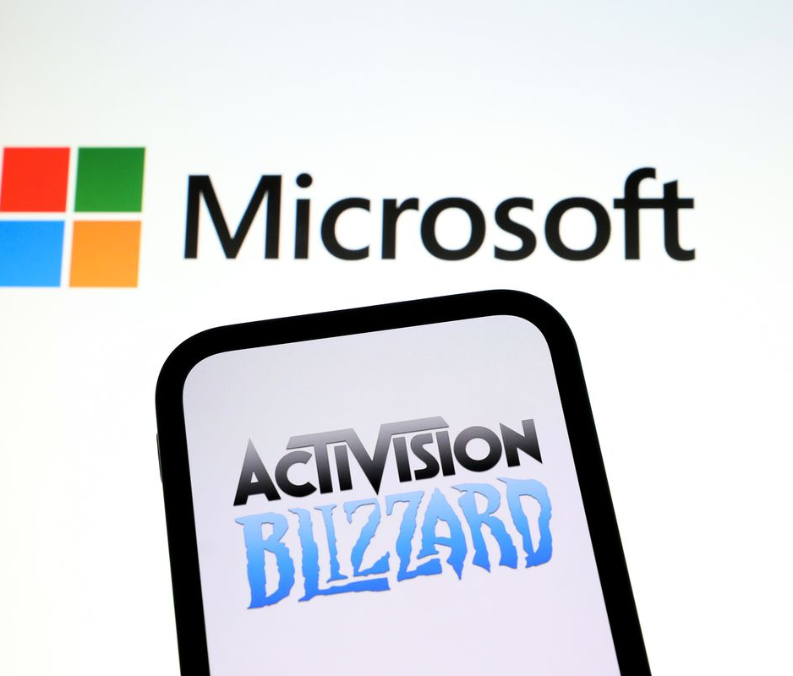
Problem Statement
Context: Microsoft just announced to acquire Activision Blizzard for $68.7B in 2023 on January 18, 2022.
As the CKRW Consulting group, we aim to construct strategies for our client Microsoft to maximize its investment—accelerate the growth in Microsoft’s gaming business across mobile, PC, console, and cloud to increase its market share from 6.5% in 2020 to 20-25% in the video game industry worldwide and get back the $68.7B in the video gaming & potential metaverse field in 5 years.
We will only focus on the collaboration between Microsoft and Activision Blizzard—1) how we can increase Activision Blizzard’s gaming revenue and 2) how Activision Blizzard can help Microsoft step into the metaverse. Potential solutions may include bringing back old games, improving existing features in the games, and developing in-game non-gaming activities.
* A metaverse is a network of 3D virtual worlds focused on social connection.

Slide 4
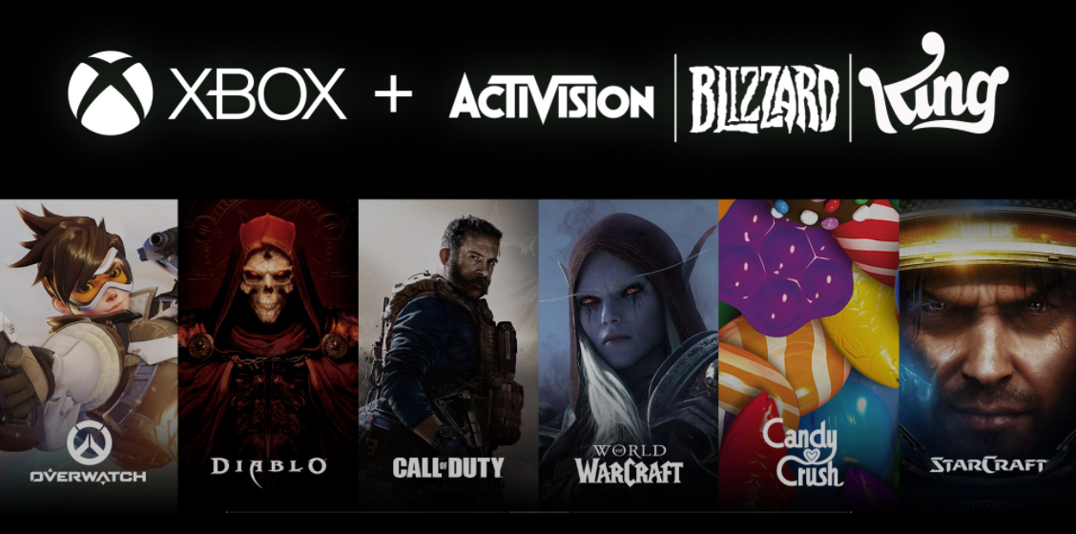
What does Microsoft see in Activision Blizzard?
“Microsoft to acquire Activision Blizzard to bring the joy and community of gaming to everyone, across every device.”
a leader in
game development
and
interactive entertainment
content publisher
Has studios around the world with nearly
10,000 employees
Has annual revenue (2021) of
8.8 billion U.S. dollars

Slide 5
Our Approaches --2 Problems to Solve
How can we improve Activision Blizzard’s revenue to increase Microsoft’s market share in the video gaming market?
How can we utilize Activision Blizzard’s current platforms, talents, and experience to increase our market share in the emerging metaverse market?

Slide 6
Activision Blizzard Revenue Analysis
Company Overview, Income, & Ranking
Revenue by Platform & Distribution Channel
Revenue by Type

Slide 7
Activision Blizzard Revenue Analysis: Logics
Take an overview of Activision Blizzard’s history with its revenue & income
See Activision Blizzard’s segmented revenue to understand its strength, weakness, & the trend of sources of revenue

Slide 8
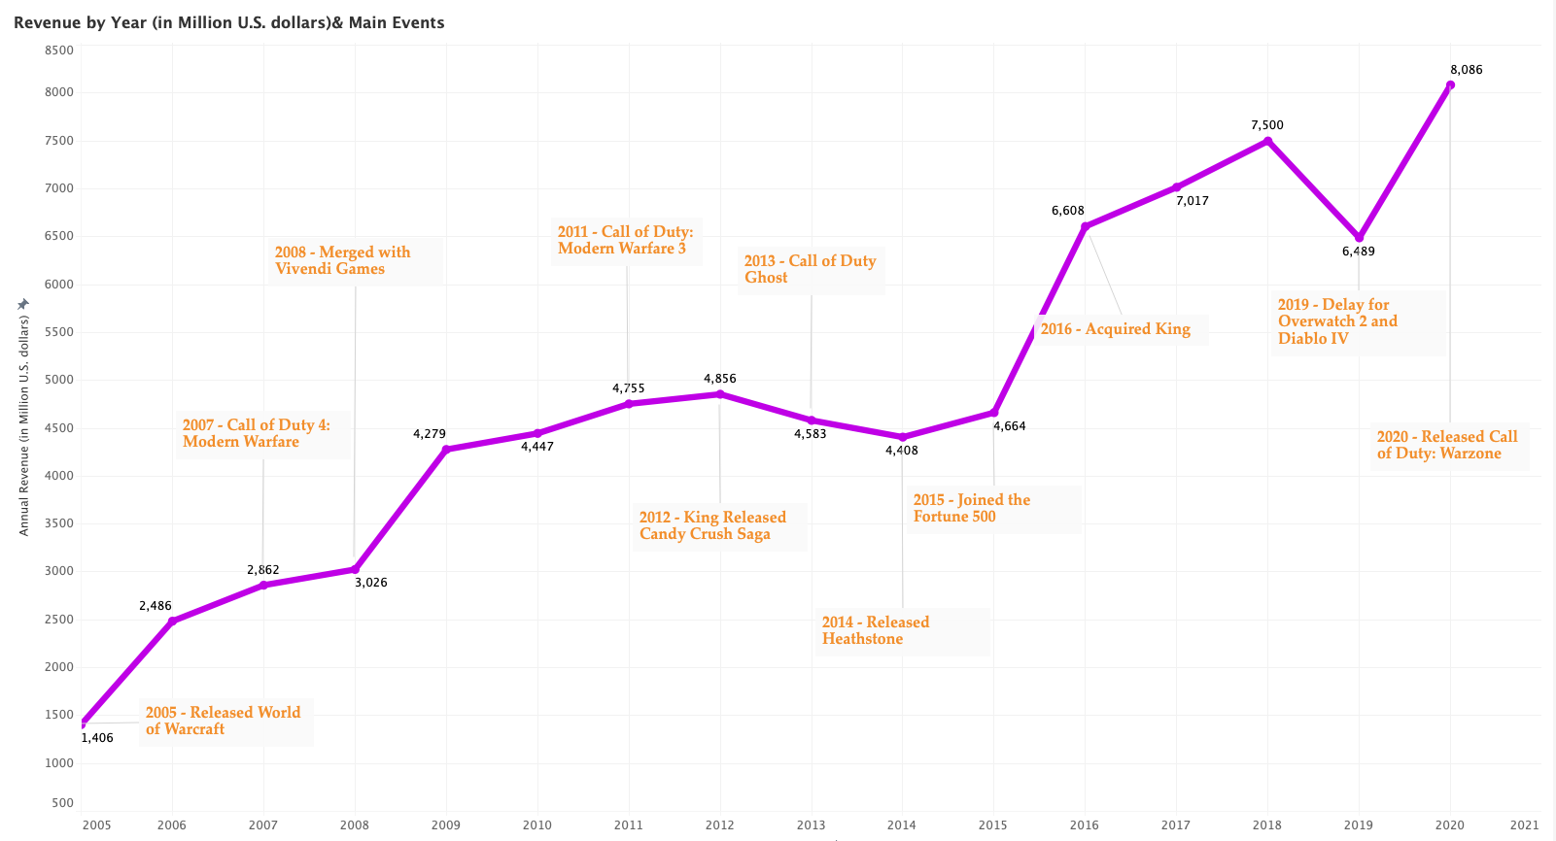
Activision Blizzard: Company Overview, Income, & Ranking
Source of data: Activision Blizzard Annual Reports
Notes:
This Chart contains Activision Blizzard’s annual revenue from 2005 to 2021 and all the major events in the company’s recent history. We can see that the ability to persistently releasing best-selling games and expanding popular franchises are especially important in maintaining a high revenue growth. Opposingly, any delay for popular games will impact revenue negatively.

Slide 9
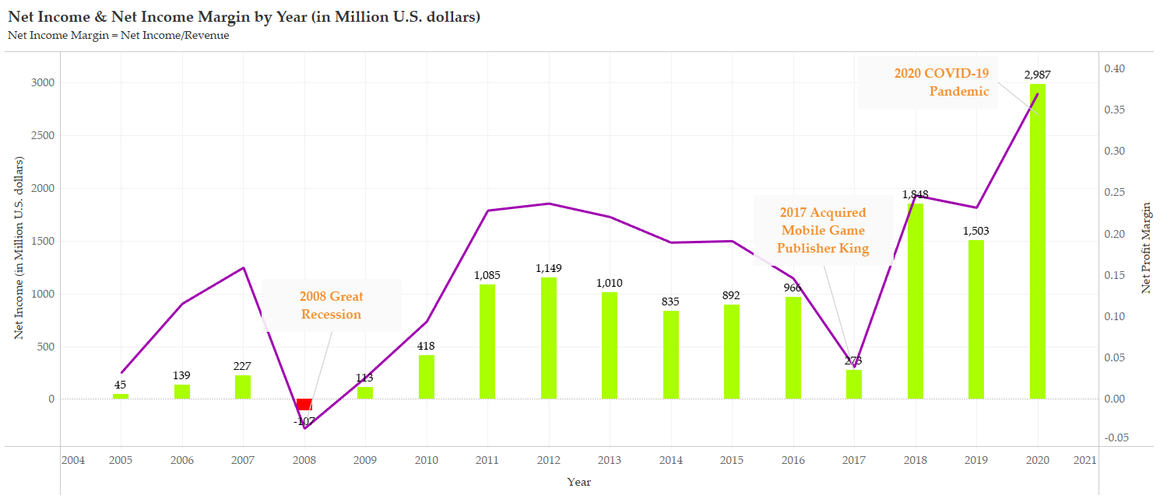
Activision Blizzard: Company Overview, Income, & Ranking
Source of data: Activision Blizzard Annual Reports
Notes:
It seems like the net income margin is closely related to the entire market / economics condition. In 2008, net income was negative, which could be closely related to the 2008 great recession. 2017 the net income is down a lot, which could be the result of acquiring king (Mobile game publisher). Later in 2020, the high net-income and net income margin is likely the result of the Covid-19 pandemic. Overall, it clear the Activision is in the right track as it is consistently increasing it net income and net income margin.

Slide 10
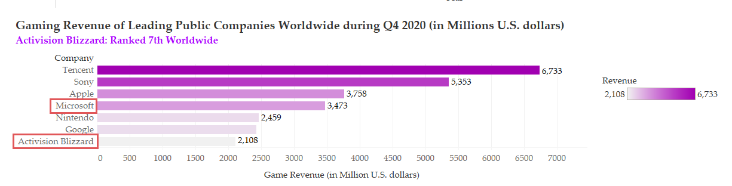
Activision Blizzard: Company Overview, Income, & Ranking
Source of data: Statista Activision Blizzard Report
Notes:
The chart above is the ranking of the top gaming companies with the highest revenues. Activision Blizzard currently ranked as the 7th largest while Microsoft ranked as the 4th largest in terms of revenue. If we combine Activision Blizzard and Microsoft, their combined revenue will surpass Sony, which makes the the 2nd largest gaming company in in terms of revenue.

Slide 11
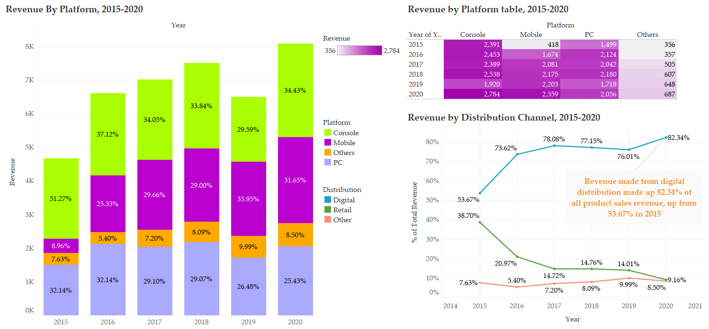
Activision Blizzard: Revenue by Platform & Distribution Channel
Source of data: Activision Blizzard Annual Reports
Notes:
The revenue by platform chart shows us the mobile games are bringing in more and more revenue over the past 5 years. Currently, Activision Blizzard only has one iconic mobile games, candy crush. Successful mobile games such as Candy Crush can be cash generating machines so Activision Blizzard should spend some effort in develop and expanding their mobile product line. In the bottom left chart, we can see that other forms of retail distribution are becoming obsolete and digital distribution of game is the way to go in the future. Perhaps focusing on digital retail could be more effective for Activision Blizzard to avoid unnecessary operation / supply chain costs and complications that are associated with retail distribution.

Slide 12
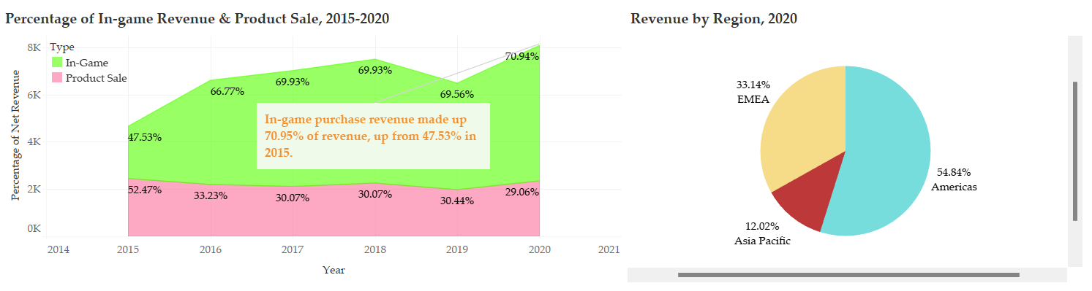
Activision Blizzard: Revenue by Type
Source of data: Activision Blizzard Annual Reports
Notes:
The chart above shows the increase in percentage of in-game sales over the past 5 years. As In-game purchases becomes a more prevalent source of revenue for Activision Blizzard, Activision Blizzards to create more contents / methods to increase their in-games sales. The pie chart on the right shows Activision Blizzard’s 2020 revenue by region. Americas made up more than half of the revenue, followed by EMEA and Asia Pacific regions.

Slide 13
Old Games Analysis
Popular Genre Analysis
Popular Genre & Platform Cross Analysis
Game Relaunch Recommendations

Slide 14
Bring Back the Old Games: Logics
Determine genres and platforms of games are popular now and in the future
Find the old Activision Blizzard games that fit these patterns
Choose the suitable old games to revive

Slide 15
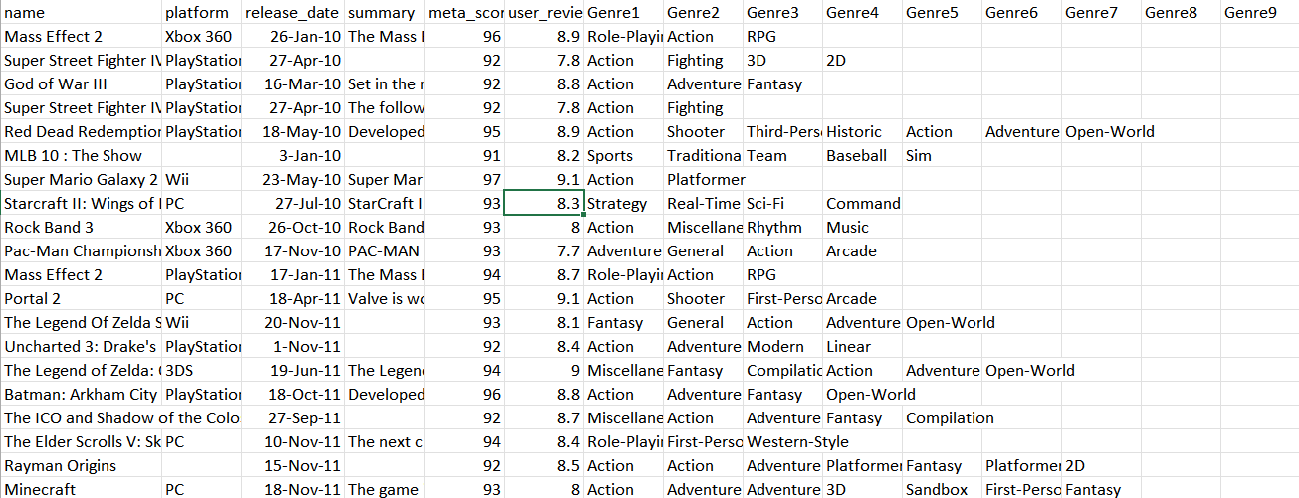
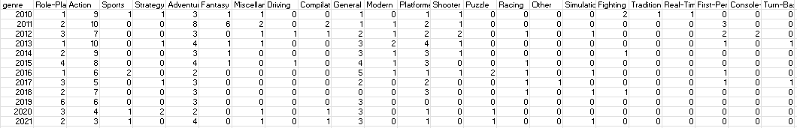
Old Games Analysis: Dataset--Top Video Games 1995-2021 Metacritics
Dataset Explanation: The Top Video Games 1995-2021 Metacritics dataset contains the top 200 console games published each year based on Metascore from 1995-2021, with game names, platforms, MetaScores, and User Review Scores listed. To enable genre analysis, we then selected top 10 console games published each year based on Metascore from 2010-2021 and added the genres of each game manually through standardized research. *RPG: Role-Playing Game

Slide 16
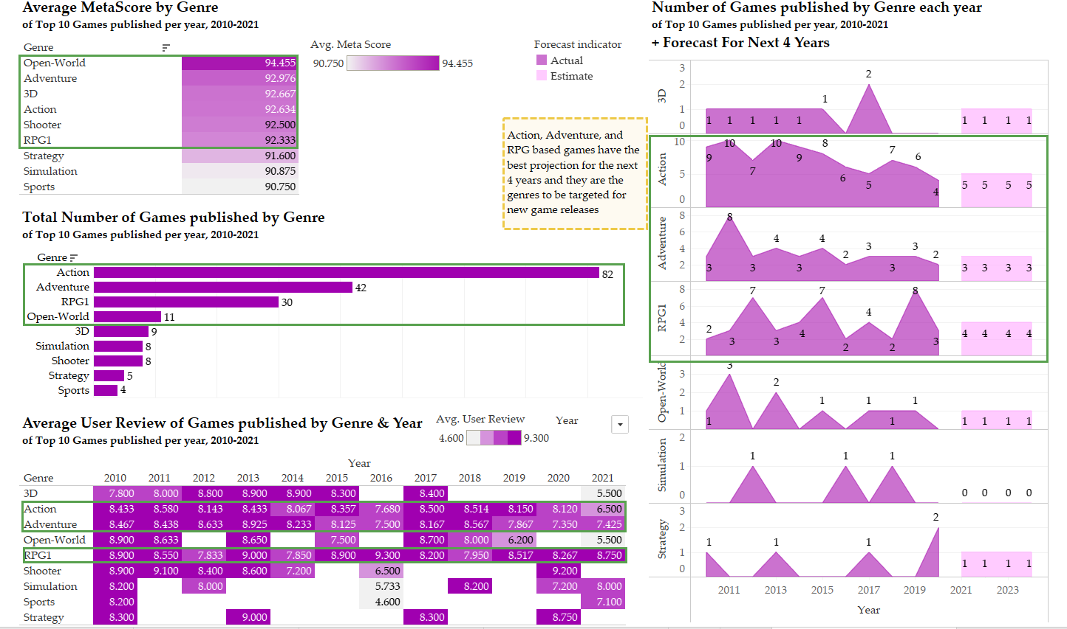
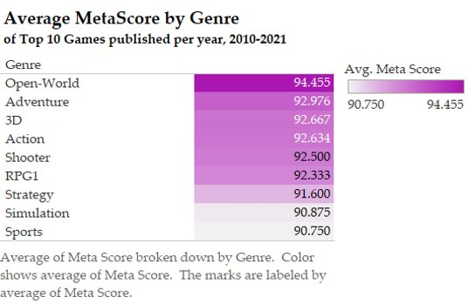
Old Games Analysis: Popular Genre Analysis (View in Tableau)
Source of Data: Top Video Games 1995-2021 Metacritic. Metacritic, Statista
Notes:
The 'Average MetaScore by Genre' is calculated by using the average MetaScore of the top 10 games released every year from 2010 to 2021. 6 genres (Open-World, Adventure, 3D, Action, Shooter, RPG) have a pretty high average MetaScore ranging between 94 and 92 providing us plenty of options to choose from the old games released by Activision.

Slide 17
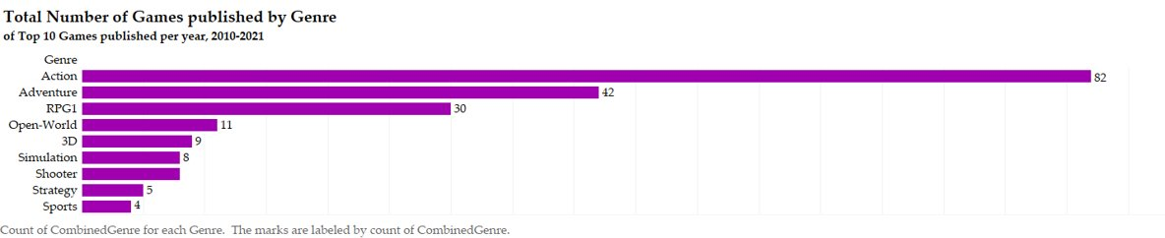
Old Games Analysis: Popular Genre Analysis (View in Tableau)
Source of Data: Top Video Games 1995-2021 Metacritic. Metacritic, Statista
Notes:
'Total Number of Games published by Genre' is calculated by using the top-10 games released per year between 2010-21. This provides an insight into the sample size of the data that we have used for our analysis.

Slide 18
Old Games Analysis: Popular Genre Analysis (View in Tableau)
The plots of sum of 3D (actual & forecast), sum of Adventure (actual & forecast), sum of RPG1 (actual & forecast), sum of Open-World (actual & forecast), sum of Simulation (actual & forecast), and sum of Strategy (actual & forecast) for Year. Color shows details about Forecast indicator.
Source of Data: Top Video Games 1995-2021 Metacritic. Metacritic, Statista
Notes:
'Number of Games published by Genre each year of Top 10 Games published per year, 2010-2021 + Forecast For Next 4 Years' provides us the total number of games released per genre between 2010-21 and a 4-year forecast providing an insight into how many games can be released from a particular genre in the upcoming 4 years. Action, Adventure, and RPG based games have the best projection for the next 4 years and they are the genres to be targeted for new game releases

Slide 19
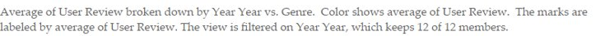
Old Games Analysis: Popular Genre Analysis (View in Tableau)
Source of Data: Top Video Games 1995-2021 Metacritic. Metacritic, Statista
Notes:
The 'Average User Review of Games published by Genre & Year' is calculated by using the average user review from the top-10 games released every year from 2010 to 2021. Adventure, Action, RPG) have a pretty consistent positive average user review over the last 4-5 years providing us an insight into what genre of games users/players like to play in the current market.

Slide 20
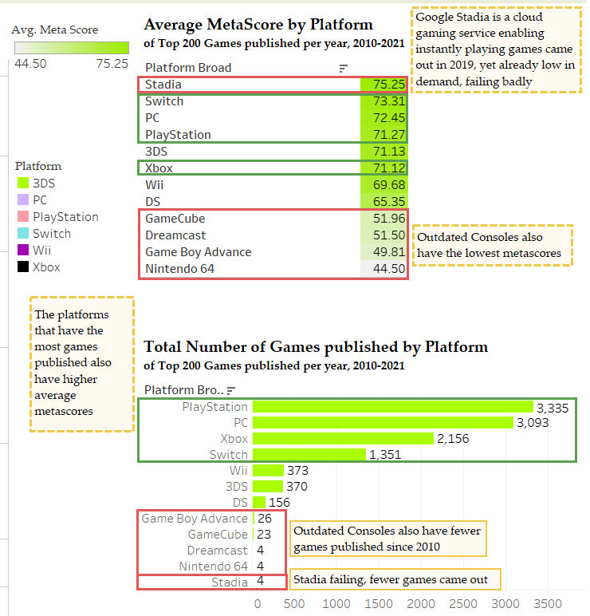
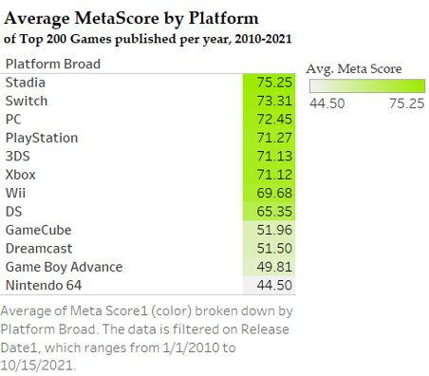
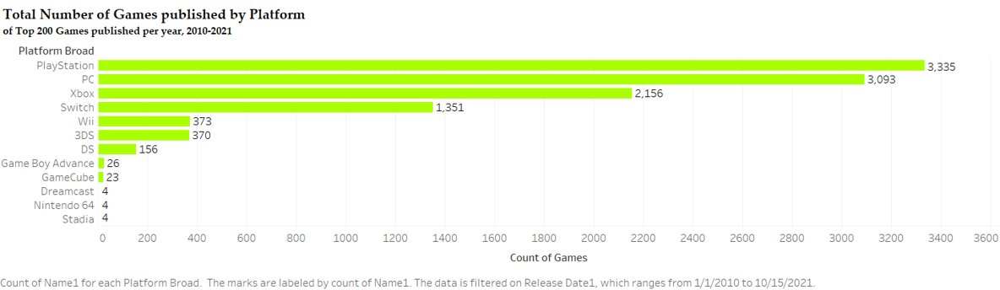
Old Games Analysis: Popular Genre & Platform Cross Analysis (View in Tableau)
Source of Data: Top Video Games 1995-2021 Metacritic. Metacritic, Statista
Notes:
'Average MetaScore by Platform' is the average MetaScore by platform of the top-200 games released every year between 2010-21. Stadia, Switch, PC, PlayStation, and 3DS are the highest scoring platform between 2010-21 while platforms such as DS, GameCube, Dreamcast, Game Boy Advance, and Nintendo 64 have the lowest scores signaling their decline in performance.
'Total Number of Games published by Platform' tells us on what platform where the top-200 games each year between 2010-21 were published on. PlayStation, PC, Xbox, and Switch have had the most games released with each of them having 1000+ games between 2010-21 giving an insight into their popularity among users. Gameboy Advance, GameCube, Dreamcast, Nintendo64, and Stadia have combined seen a release of 61 games on them signaling the decline in their popularity.

Slide 21
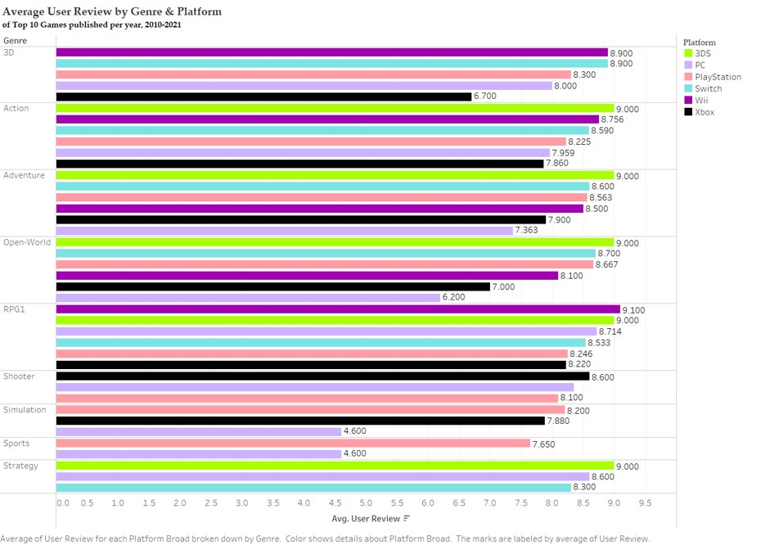
Old Games Analysis: Popular Genre & Platform Cross Analysis (View in Tableau)
Source of Data: Top Video Games 1995-2021 Metacritic. Metacritic, Statista
Notes:
'Average User Review by Genre & Platform' has been calculated by using the top 10 games released per year between 2010-21. It provides an insight into what consoles users prefer to use when playing a particular genre of game.

Slide 22

Blood Omen: Legacy Of Kain (1997)
Genre: Role-Playing, Action, Adventure
User Reviews: 8.6(PC)
Preferred Console for Release of New Game : Wii, 3DS
Notes:
'Blood Omen- Legacy of Kain' is an role-playing, adventure and action genre based game released in 1997 by ActiVision. All three of these genres (action, adventure and open-world) are among the top scorers in average 'MetaScore by Genre' category scoring 92.976(Adventure), 92.364(Action), 92.333(Role-Playing) respectively. The scores for all three of these genres are again among the top in 'Average User Review by Genre & Year' category which made us go for 'Blood Omen- Legacy of Kain'. As per our analysis, 3DS and Wii have been the preferred consoles among users for action, adventure, and role-playing games.

Slide 23

Gun (2005)
Genre: Action, Adventure, Open-World
MetaCritic Rating: 76(PC), 77(PS2), 75(Xbox 360)
User Review: 7.9(PC), 8.8(PS2), 7.6(Xbox 360)
Preferred Console for Release of New Edition : 3DS, Switch, PlayStation
Notes:
'Gun' is an action, adventure and open-world genre based game released in 2005 by ActiVision. All three of these genres (action, adventure and open-world) are among the top scorers in average 'MetaScore by Genre' category scoring 94.455(Open-World), 92.976(Adventure), 92.364(Action) respectively. The scores for all three of these genres is again among the top in 'Average User Review by Genre & Year' category which made us go for 'Gun'. As per our analysis, 3DS, Switch, and PlayStation have been the preferred consoles among users for Action, Adventure, and Open World based games.

Slide 24

Prototype 2 (2012)
Genre: Action, Adventure, Open World
MetaCritic Ratings: PC (76), PS3(79), Xbox 360(74)
User Review: PC(6.6), PS3(6.8), Xbox(7.0)
Preferred Console for Release of New Game : 3DS, Switch, PlayStation
Notes:
'Prototype 2' is an action, adventure and open-world genre based game released in 2012 by ActiVision. All three of these genres (action, adventure and open-world) are among the top scorers in average 'MetaScore by Genre' category scoring 94.455(Open-World), 92.976(Adventure), 92.364(Action) respectively. The scores for all three of these genres is again among the top in 'Average User Review by Genre & Year' category which made us go for 'Prototype 2'. As per our analysis, 3DS, Switch, and PlayStation have been the preferred consoles among users for Action, Adventure, and Open World based games.

Slide 25
Metaverse Analysis
Twitch Streaming Data Analysis, 2016-2021*
Metaverse Activities*
Ad Revenue (Social Media X Gender)*
Metaverse Segmentation: Gamer Personas*

Slide 26
Metaverse Analysis
Twitch Streaming Data Analysis, 2016-2021*
Twitch Global Analysis
Twitch Top Viewed Games' Analysis
Metaverse Activities*
Ad Revenue (Social Media X Gender)*
Metaverse Segmentation: Gamer Personas*

Slide 27
Metaverse Analysis—Twitch Streaming Data Analysis: Logics
See the potential of metaverse through the trend of online socializing & gaming activities on Twitch
Find the top viewed games on Twitch and see which Activision Blizzard games can be added metaverse features

Slide 28
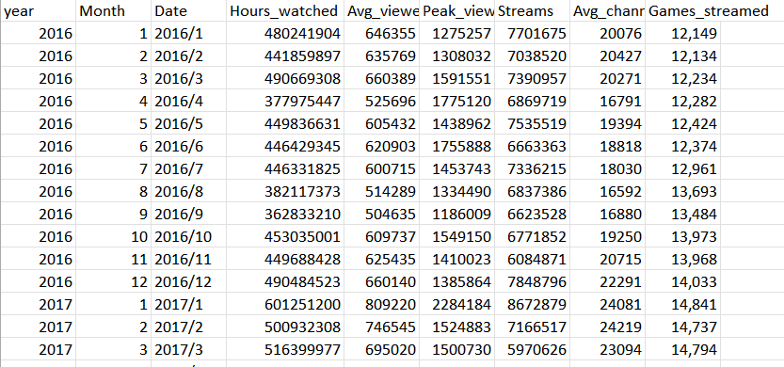
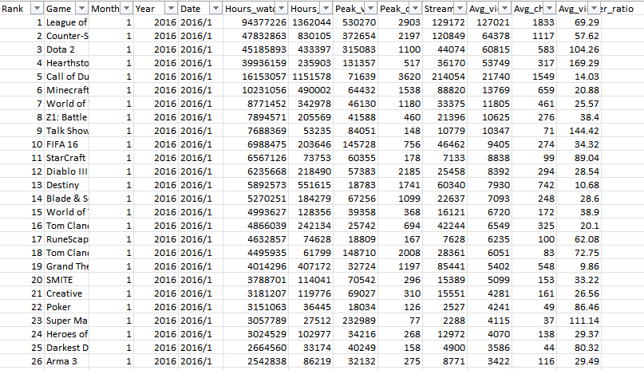
Metaverse Analysis—Data: Twitch Gaming Streaming, 2016-2021
Source of Data: Twitch game data (2016-2021). Kaggle & Twitch.

Slide 29
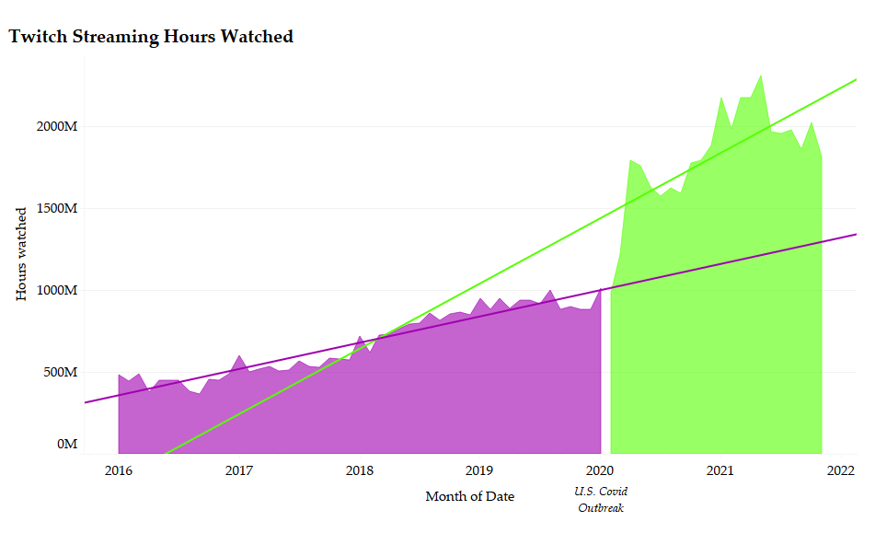
Metaverse Analysis—Twitch Global Analysis: Covid Promotes online social activities
Hours watched = 1089000*Month of Date + -46.30
(p-value < 0.001)
Hours watched = 438370*Month of Date + -18.22
(p-value < 0.001)
Source of Data: Twitch game data (2016-2021). Kaggle & Twitch.
Notes:
The Twitch Streaming Hours Watched graph shows the total streaming hours watched on Twitch from 2016 to 2021. Through regression analysis, we can see a huge increase of hours watched after the U.S. Covid Outbreak in March 2020. It shows that the pandemic has promoted online activities: people are getting used to socialize via online platforms.

Slide 30
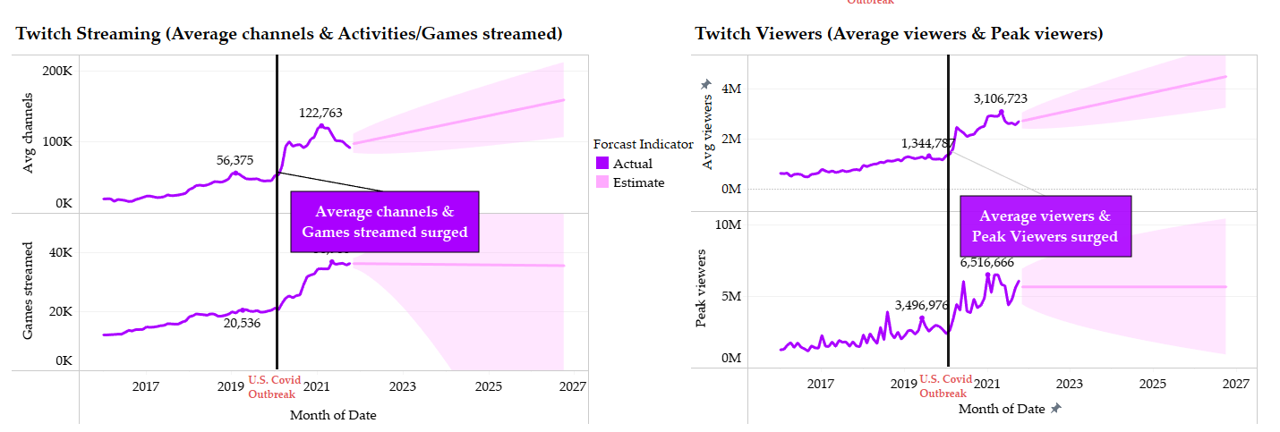
Metaverse Analysis—Twitch Global Analysis
The forecast indicates average channels will continue to increase
However, gamers tend to pay attention to only several games—better to launch only one or two games after the acquisition. Incorporating more metaverse activities in only several games is instead a trend.
The forecast indicates average viewers will continue to increase
Peak viewers per month trend is relatively volatile—people are more attracted to new game launches and special events
Source of Data: Twitch game data (2016-2021). Kaggle & Twitch.
Notes:
The Twitch Streaming (Average channels & Activities/Games streamed) graph shows the average channels and number of games/activities streamed on Twitch from 2016 to 2021. The forecast indicates average channels will continue to increase. However, gamers tend to pay attention to only several games—better to launch only one or two games after the acquisition. Incorporating more metaverse activities in only several games is instead a trend.
The Twitch Viewers (Average viewers & Peak viewers) graph shows the average viewers and peak viewers on Twitch from 2016 to 2021. The forecast indicates average viewers will continue to increase. Peak viewers per month trend is relatively volatile—people are more attracted to new game launches and special events.

Slide 31
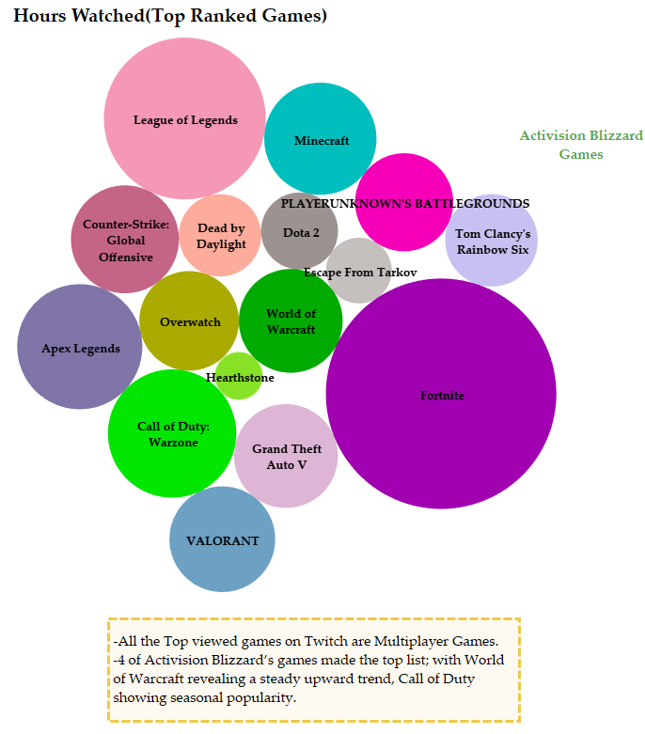
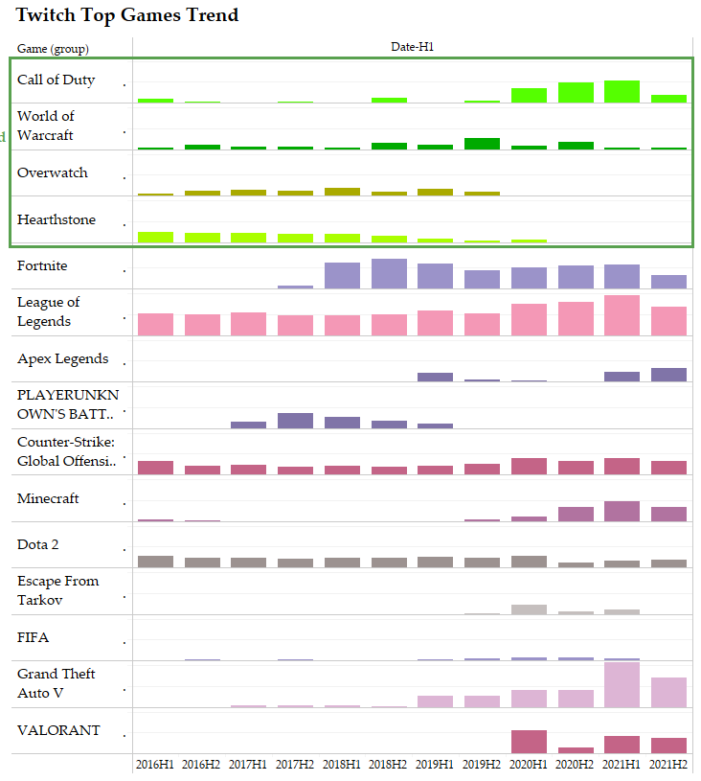
Metaverse Analysis—Twitch Top Viewed Games' Analysis
All the Top viewed games on Twitch are Multiplayer Games.
4 of Activision Blizzard’s games made the top list; with World of Warcraft revealing a steadily upward sloping trend, Call of Duty showing seasonal popularity.
Source of Data: Twitch game data (2016-2021). Kaggle & Twitch.
Notes:
The Hours Watched(Top Ranked Games) graph shows the games with the highest streaming hours watched on Twitch from 2016 to 2021, ranked by circle sizes. The Twitch Top Games Trend graph shows the 6-month total hours watched on Twitch from 2016 to 2021. 4 Activision Blizzard games (in green) made the top list. We can see that all the Top viewed games on Twitch are Multiplayer Games. And among the 4 Activision Blizzard games, World of Warcraft and Call of Duty reveal steadily upward sloping trends and constant popularity, can be incorporated some metaverse features.

Slide 32
Metaverse Analysis
Twitch Streaming Data Analysis, 2016-2021*
Metaverse Activities*
Games are the starting point and most viable path towards the metaverse
Main Metaverse Activities
Target Market in the Short-run
Ad Revenue (Social Media X Gender)*
Metaverse Segmentation: Gamer Personas*
Notes:
A metaverse is a network of 3D virtual worlds focused on social connection.

Slide 33
Metaverse Analysis—Metaverse Activities: Logics
Discover how games are the starting point and most viable path towards the metaverse
See the current metaverse activity distributions and which ones we can adopt in our design
Examine our target market of metaverse in the short run

Slide 34
Games are the starting point and most viable path towards the metaverse
60% of U.S. gamers participated in non-gaming activities within games in 2021
59% of U.S. adults are gamers
2019-2021
CAGR:
2%
2019-2021
CAGR:
10%
Source of data: Activate analysis, Activate 2019 Consumer Technology & Media Research Study (n = 4,006), Activate 2021 Consumer
Technology & Media Research Study (n = 4,018)
Notes:
According to Activate’s research in 2021, 59% of U.S. adults are gamers, and 60% of U.S. gamers participated in non-gaming activities within games in 2021. Given the huge customer base of gaming, games are the starting point and most viable path towards the metaverse
The gaming population graph reveals that the U.S. gaming population increased from 124M to 151M from 2019 to 2021, with a CAGR of 10%. The Average Monthly Video Game Dollar Spend Per Gamer graph reveals that the U.S. gaming spend increased from $19.04 to $19.93 from 2019 to 2021, with a CAGR of 2%. The gaming population has grown really fast, but the gaming spending has not been able to catch up yet. We need to think of ways to make more gamers spend money while playing.

Slide 35
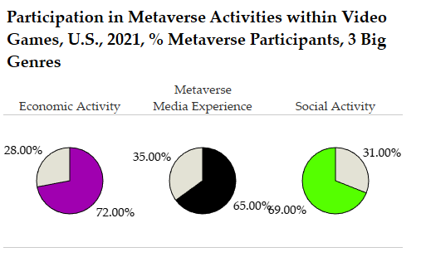
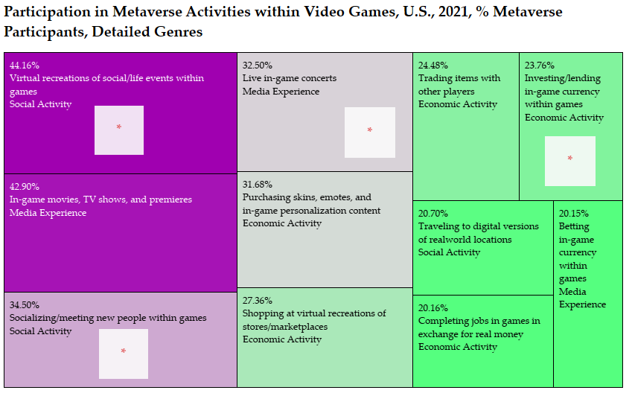

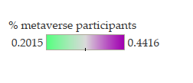
Main Metaverse Activities in 2021
Source of data: Activate analysis, Activate 2019 Consumer Technology & Media Research Study (n = 4,006), Activate 2021 Consumer
Technology & Media Research Study (n = 4,018)
Notes:
The upper left graph shows the % Participation in Metaverse Activities within Video Games among the 60% of U.S. gamers who participated in metaverse activities in 2021 for each of the 3 big categories, and the upper right graph the detailed categories. Among the top popular metaverse activities, we are capable of developing mainly the social activities within games. Besides in-game metaverse activities, Microsoft has metaverse-related applications that can use further developed, such as the Nth Floor virtual workspace collaborated with Accenture. Hence, we should allow games to have different metaverse activities available and incorporate gaming elements into other Microsoft services in the metaverse, using Activision Blizzard's gaming platforms and its interactive entertainment content design capabilities.

Slide 36
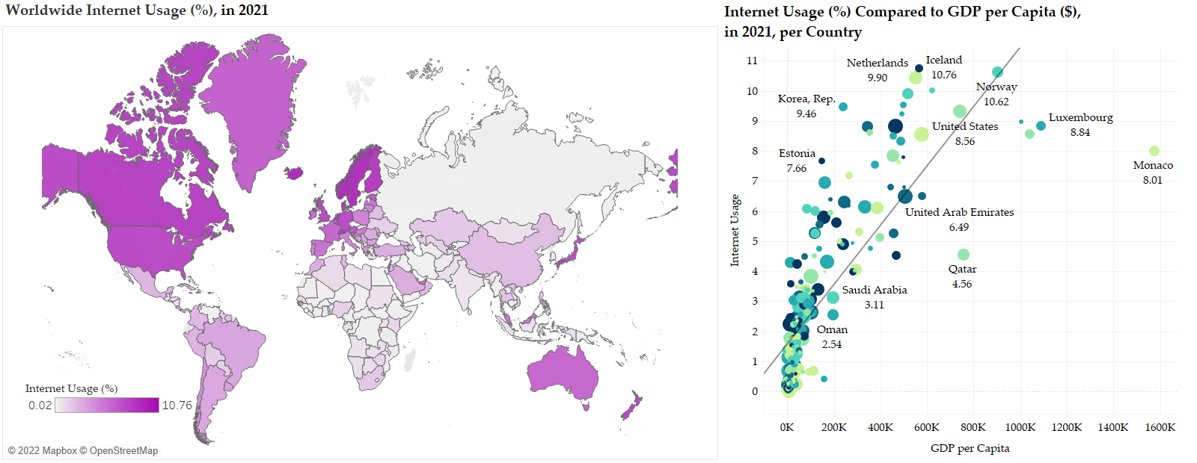
Metaverse: Target Market in the Short-run
World Internet Usage distribution matches Activision Blizzard’s revenue distribution.
The higher the country’s GDP per capita, the higher the Internet Usage.
Internet Usage = 9.869e-06 GDP per Capital + 1.584
(p-value < 0.001)
Source of data: World Indicators, World Bank
Notes:
The Worldwide Internet Usage (%), in 2021 graph indicates internet usage per country in 2021—the darker the color on the world map, the higher the internet usage (%). The Internet Usage (%) Compared to GDP per Capita ($), in 2021, per Country graph reveals the relationship between internet usage and GDP per capital for each country. According to the regression, the higher the GDP per capital, the higher the internet usage (%). Interestingly, world internet usage distribution matches Activision Blizzard’s revenue distribution. We may follow Activision Blizzard's regional revenue data to first target the Americas and then EMEA and Asia Pacific regions for our metaverse design, for which we can reach audience with higher internet usage and GDP per capita, likely drives our revenue with minimized input.

Slide 37
Metaverse Analysis
Twitch Streaming Data Analysis, 2016-2021*
Metaverse Activities*
Ad Revenue (Social Media X Gender)*
Social Media Ad Revenue and MAU
Gender Distribution (population, gaming, social media platforms)
Metaverse Segmentation: Gamer Personas*

Slide 38
Metaverse Analysis—Ad Revenue: Logics
Determine whether we should incorporate advertisement business into our metaverse design
Examine gender distribution to improve our advertisement business

Slide 39


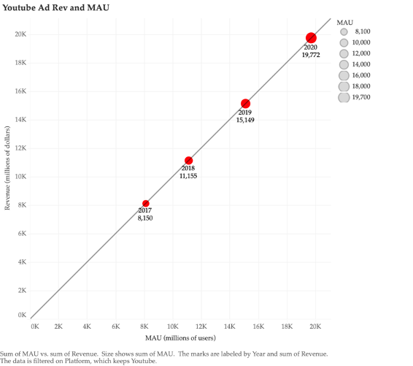
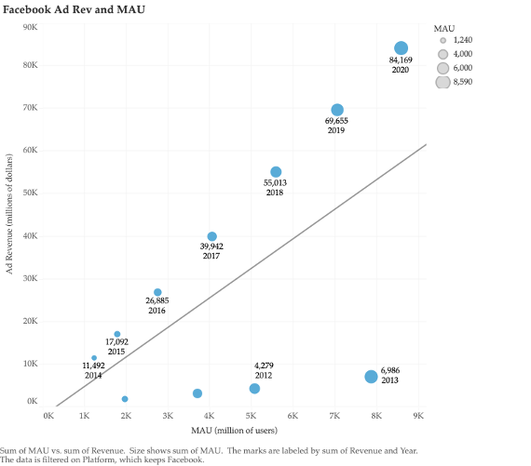
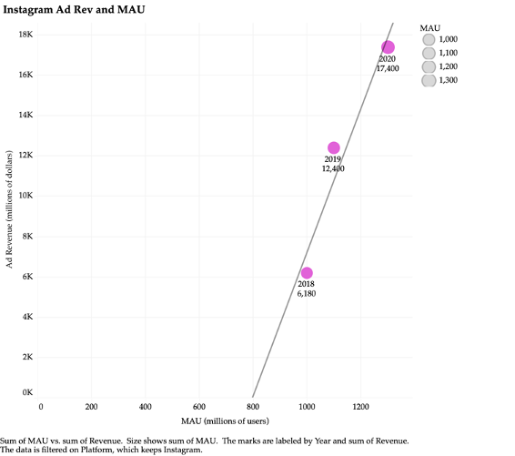

Social Media Ads Revenue & MAU (Monthly Average Users)
Instagram Ads Revenue = -28385.7 + 35.629 * MAU
(p-value = 0.161)
YouTube Ads Revenue = 34.664 + 1.001 * MAU
(p-value < 0.001)
Facebook Ads Revenue = -2216.37 + 6.939 MAU
(p-value = 0.048)
Ads Revenue is positively correlated with MAU.
→ We can utilize Activision Blizzard’ 3D design skills to enable 3D advertisement features in our metaverse design—as we have more users, Microsoft’s revenue from ads increases
Notes:
The above graphs reveal the relationships between Instagram, YouTube, and Facebook’s advertisement revenue and monthly active users, all positively correlated. Given Microsoft and Activision Blizzard’s large amount of users, we can utilize Activision Blizzard’ 3D design skills to enable 3D advertisement features in our metaverse design—as we have more users, Microsoft’s revenue from ads increases.

Slide 40
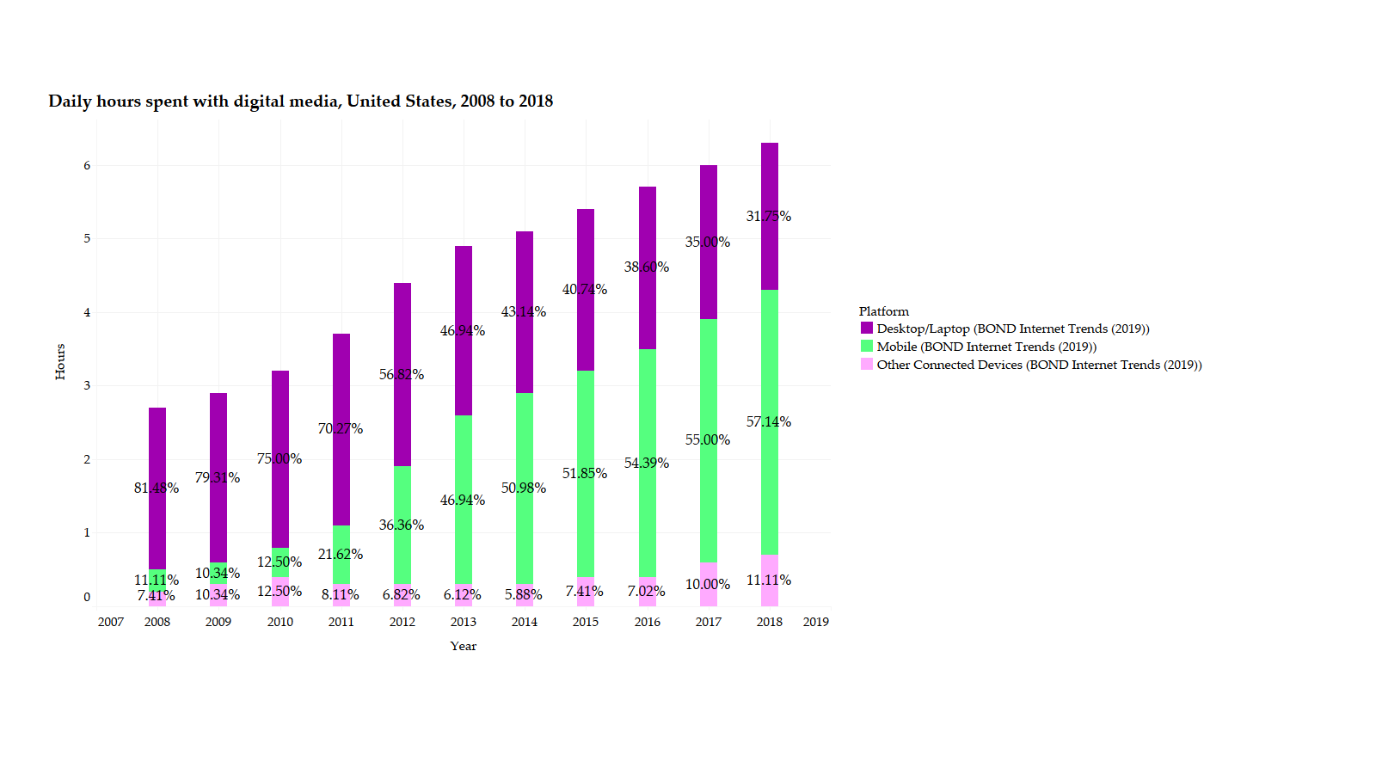
Gender Distribution: Daily Hours Spent with digital media, U.S., 2008-2018
Daily hours spent with digital media has been increasing
Mobile market is the most popular—easier access
Source of data: BOND Interest Trends
Notes:
The Daily hours spent with digital media, United States, 2008 to 2018 graph indicates that daily hours spent with digital media has been increasing and mobile market is the most popular with an easier access. It implies that we need to expand our metaverse market by connecting to the mobile market.

Slide 41
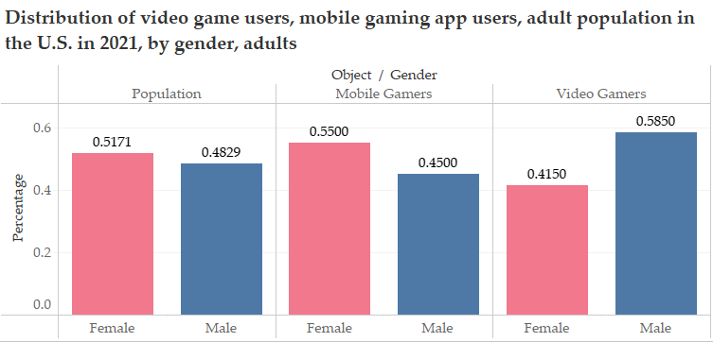
Gender Distribution: Gamers in the U.S., in 2021, by Gender
U.S. Female Adult Population > Male Adult Population
Female mobile gamers are 11 percentage points higher than male mobile gamers
Male video gamers are 17 percentage points higher than female mobile gamers
Source of data:
Distribution of mobile gaming app users in the United States as of January 2021, by gender. eMarketer; Jun Group
https://www-statista-com.eu1.proxy.openathens.net/statistics/1243409/us-mobile-gaming-users-gender/
Distribution of video game users in the United States in 2021, by gender. Statista; Statista Advertising & Media Outlook
https://www-statista-com.eu1.proxy.openathens.net/forecasts/494867/distribution-of-gamers-by-gender-usa
Notes:
The Distribution of video game users, mobile gaming app users, adult population in the U.S. in 2021, by gender, adults graph indicates that U.S. female adult population is larger than male population, but male video gamers are much than female video gamers. For the mobile market, however, female gamers made up a higher percentage than male gamers.

Slide 42
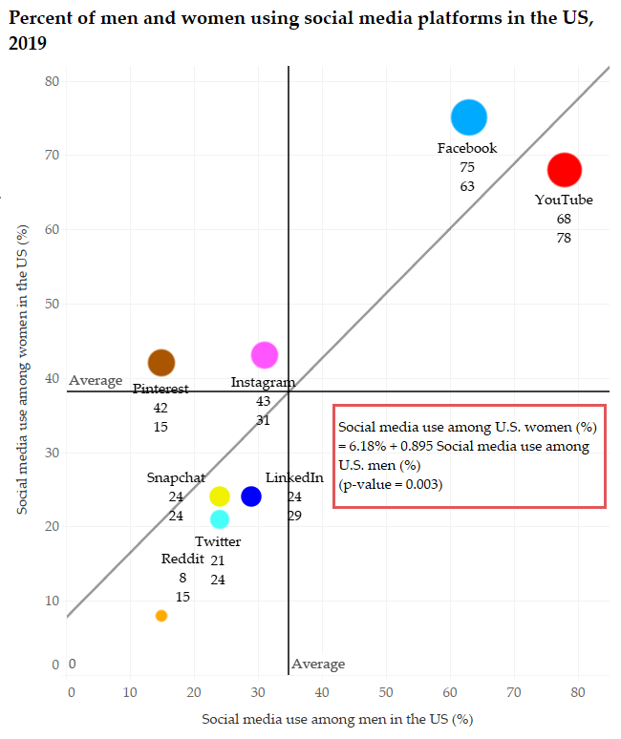
Women use social media platforms more than men do
-On average, more women use social media platforms than men do, especially the life sharing platforms such as Instagram, Pinterest, and Facebook.
-Men tend to use gaming and Esports related social media platforms more, such as YouTube.
Source of data: Users by social media platforms (Statista and TNW (2019)). Pew Research Center (2019)
Notes:
The Percent of men and women using social media platforms in the US, 2019 graph shows the percentage of U.S. male and female who use a social media platform in 2019. On average, more women use social media platforms than men do, especially the life sharing platforms such as Instagram, Pinterest, and Facebook. Men tend to use gaming and Esports related social media platforms more, such as YouTube. Hence, to increase our MAU, if we launch new games or products, we can easily approach male gamers; but for women, who engage in more mobile games and life sharing social media platforms, we need to develop Activision Blizzard's mobile games more in favor of the female gamers, adding socializing/event-sharing features to maximize the utility of ads and emphasizing the "One Microsoft Platform" idea (increase the loyalty and the willingness to share of our customers). We need to expand our metaverse market by connecting to the mobile market, improving our ability to attract businesses creating ads on our platform and create new user behaviors through attachment to game IP.

Slide 43
Metaverse Analysis
Twitch Streaming Data Analysis, 2016-2021*
Metaverse Activities*
Ad Revenue (Social Media X Gender)*
Metaverse Segmentation: Gamer Personas*
Gamer Persona Descriptions
Gamer Persona Analysis

Slide 44
Metaverse Analysis—Metaverse Segmentation: Gamer Personas
How can gamers be segmented beyond gender? Determine 6 gamer personas
Which gamer personas should we target? How do we attract different gamer personas? (We need to expand our metaverse market by connecting to the mobile market, improving our ability to create new user behaviors through attachment to game IP. )

Slide 45
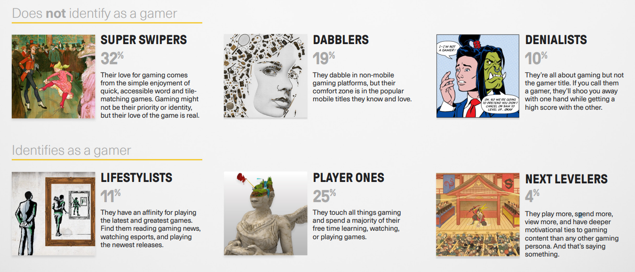
Metaverse Segmentation: Gamer Persona Description
Source of Data: Gallery of the Gamer-Modern Gamer Personas. Activision Blizzard Media..

Slide 46
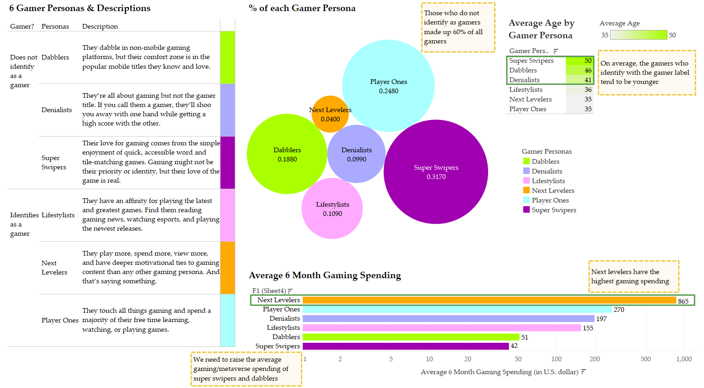
Metaverse Segmentation: Gamer Persona Analysis
Source of Data: Gallery of the Gamer-Modern Gamer Personas. Activision Blizzard Media..
Notes:
The % of each Gamer Persona shows the percentage of each gamer persona. Super Swipers take up the highest percentage of 31.7%, and gamers that do not identify as gamers take up 60% of all gamers. These gamer personas were conducted by Activision Blizzard Media and through this we are able to determine ways to determine ways to increase our in-game revenue and also to expand our metaverse market by connecting to the mobile market, improving our ability to create new user behaviors through attachment to game IP.
The Average Age by Gamer Persona graph shows the average age per gamer persona. Super Swipers are the oldest gamer personas because these games are typically rather simple and addicting mobile games, which is perfect for this age group since they may not be as tech savvy as the younger generations. On average, gamers who identify with the gamer label tend to be younger.
The Average 6 Month Gaming Spending graph shows the average 6-month gaming spending for each gamer persona. Next Levelers make up only 4% of the gamer personas, however their average 6-month spending is greater than all the personas combined. We need to think of ways to raise the average gaming/metaverse spending of super swipers and dabblers. Super Swipers are the compromise the largest gamer personas, however, their average 6 month spending is the least of all personas. Therefore, our recommendation is to promote in-game advertisement and spending to this persona specifically and other personas in order to increase our overall in-game revenue.

Slide 47
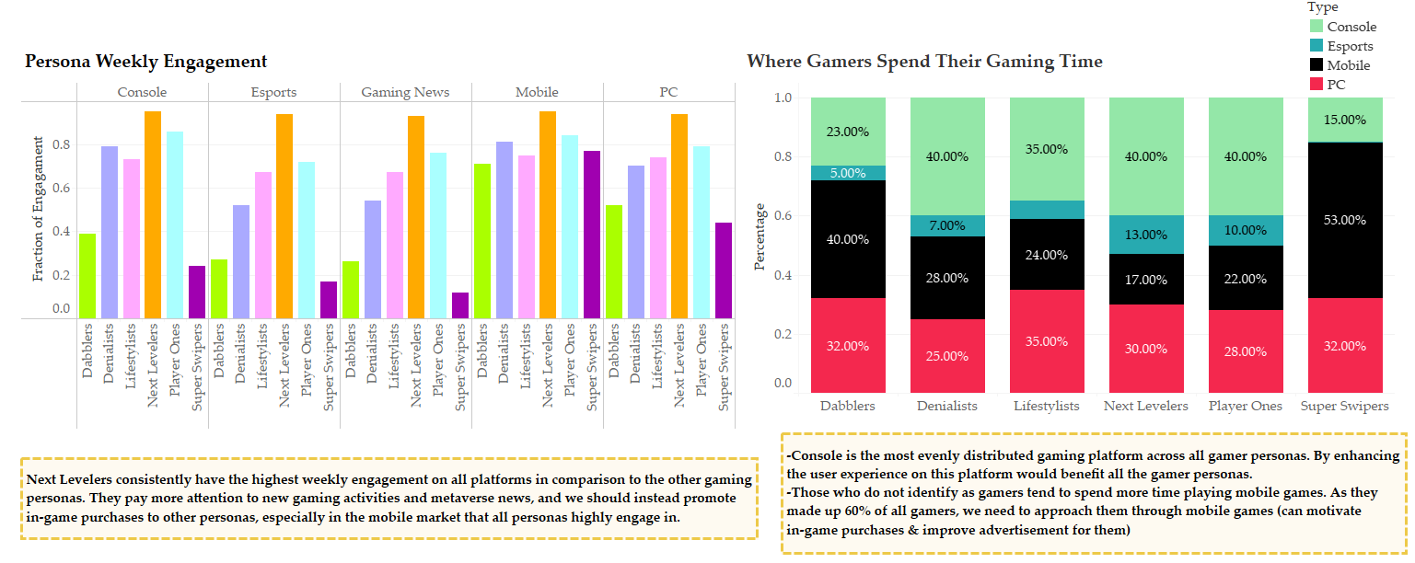
Metaverse Segmentation: Gamer Persona Analysis
Source of Data: Gallery of the Gamer-Modern Gamer Personas. Activision Blizzard Media..
Notes:
These two graphs illustrate each of the gamer persona’s weekly engagement and where they spend their gaming time across the different platforms which are Console, Esports, Gaming News, Mobile, and PC. This data allows us to see which platforms have the highest engagement through the different personas, and combining our knowledge of how large the persona group is, the age, and the average spending we are able to narrow our focus and determine where we can focus our marketing efforts and how we can transition these groups to the metaverse.
Next Levelers consistently have the highest weekly engagement on all platforms in comparison to the other gaming personas. They pay more attention to new gaming activities and metaverse news, and we should instead promote in-game purchases to other personas, especially in the mobile market that all personas highly engage in.
Console is the most evenly distributed gaming platform across all gamer personas. By enhancing the user experience on this platform would benefit all the gamer personas. Those who do not identify as gamers tend to spend more time playing mobile games. As they made up 60% of all gamers, we need to approach them through mobile games (can motivate in-game purchases & improve advertisement for them)

Slide 48
Strategies Conclusion
Increase Revenue & Market Share in the Gaming & Metaverse Market
Bring Back Old Games
Gun
Metaverse
Developing social activity metaverse features in games and gaming features in metaverse platforms using Activision Blizzard’s strength
Prototype 2
Blood Omen: Legacy of Kain
First target the Americas region for our metaverse design
Enable 3D advertisement in our metaverse platform
Metaverse market
<->
Mobile market
Ability to create new user behaviors through attachment to game IP
Adding life-sharing/socializing features in games/metaverse platforms targeting women
Promoting purchases from gamers who do not identify as gamers—focusing on the mobile market
“One Microsoft Platform” idea

Slide 49
References/Source of Data
Video Game Industry in the U.S. Statista.
https://www.statista.com/statistics/421848/game-revenues-global-companies/
Activision Blizzard Annual Reports. Activision Blizzard.
https://investor.activision.com/annual-reports
Top Video Games 1995-2021 Metacritic.
https://www.kaggle.com/deepcontractor/top-video-games-19952021-metacritic
Gallery of the gamer. Activision Blizzard. https://www.activisionblizzardmedia.com/content/dam/atvi/ab-media/news-resources/documents/Gallery_of_the_Gamer_-_Modern_Gamer_Personas.pdf
Activate 2019 Consumer Technology & Media Research Study (n = 4,006), Activate 2021 Consumer Technology & Media Research Study (n = 4,018). Activate analysis.
https://activate.com/wp-content/uploads/2020/11/Activate-Outlook-2021_103120.pdf
Twitch game data (2016-2021). Kaggle & Twitch.
https://www.kaggle.com/rankirsh/evolution-of-top-games-on-twitch
Global users daily time on social media apps 2020-2021, by gender. Adjoe GmbH, Statista.
https://www-statista-com.eu1.proxy.openathens.net/statistics/1272876/worldwide-social-apps-time-spent-daily-gender/
Distribution of mobile gaming app users in the United States as of January 2021, by gender. eMarketer; Jun Group
https://www-statista-com.eu1.proxy.openathens.net/statistics/1243409/us-mobile-gaming-users-gender/
Distribution of video game users in the United States in 2021, by gender. Statista; Statista Advertising & Media Outlook
https://www-statista-com.eu1.proxy.openathens.net/forecasts/494867/distribution-of-gamers-by-gender-usa

Slide 50
Thank You!

